Slide 1
DevOps Fundamentals
Will Angel
Linkedin: https://www.linkedin.com/in/william-angel/
Twitter: @DataDrivenAngel

Slide 2
Overview
Presentation : DevOps Practices and Tooling
DevOps Overview
DevOps Dora Metrics
Practices and Tools
Challenges of DevOps for Data Engineering

Slide 3
DevOps Overview

Slide 4
What is DevOps?
DevOps is how you win.
DevOps is being good at Developing and Operating software.
Developing and operating software is a continuous process, so DevOps is being good at continuously getting good at developing and operating software.

Slide 5
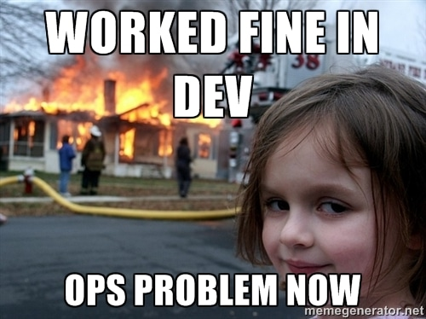
Why?
Reducing the number of handoffs required to deliver working software results in higher quality software. Having developers care about how their software is running results in higher quality software in less time.

Slide 6
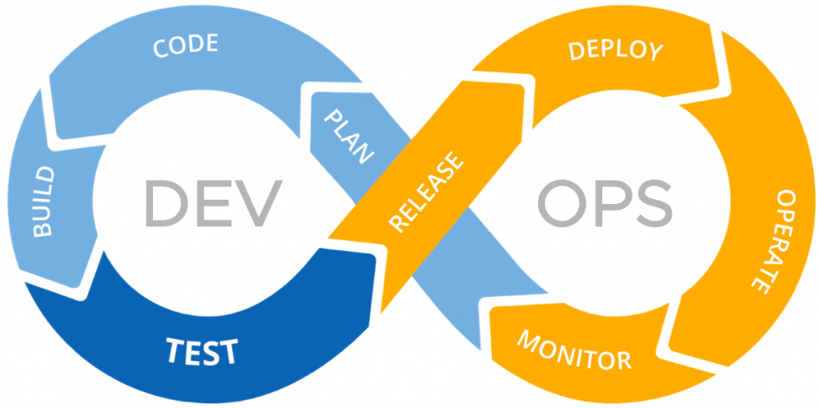
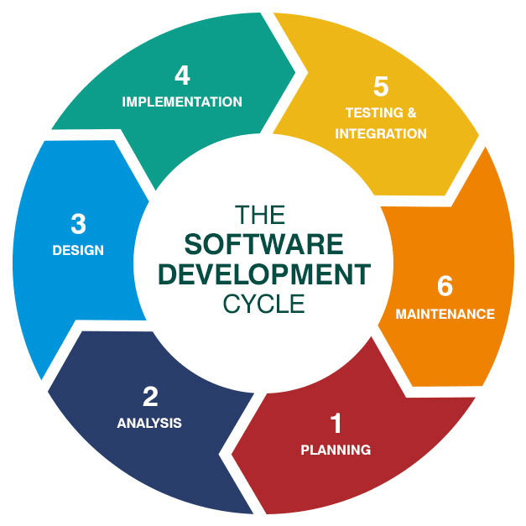
The DevOps Cycle
It’s the Software Development Lifecycle but AGILE
Notes:
Software Development is cyclical!

Slide 7
The DevOps triangle
Devops is a combination of:
Development Process
System Architecture
Technical Systems
How do you build a complex sociotechnical system of people, process, and systems that can operate effectively, change to operate in new and more effective ways, and develop software

Slide 8
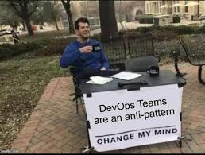
Devops is culture
“You build it, you run it”

Slide 9
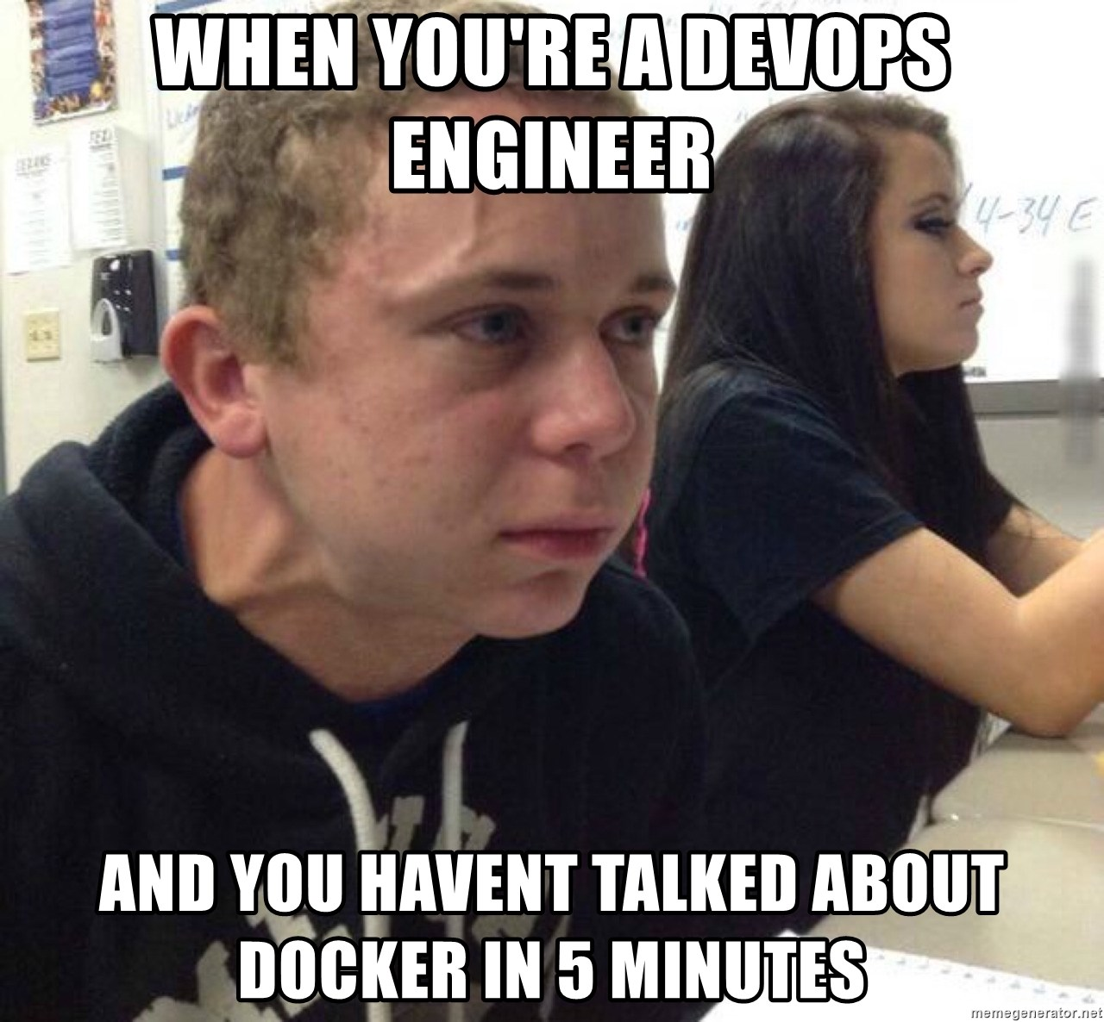
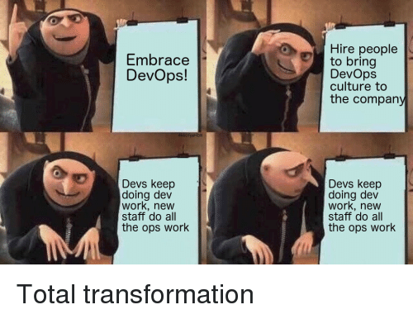
Devops is not:
DevOps is not:
Renaming your ops team to DevOps
Hiring a ‘DevOps Engineer’
Using Kubernetes everywhere.

Slide 10
So who defines what DevOps is?

Slide 11
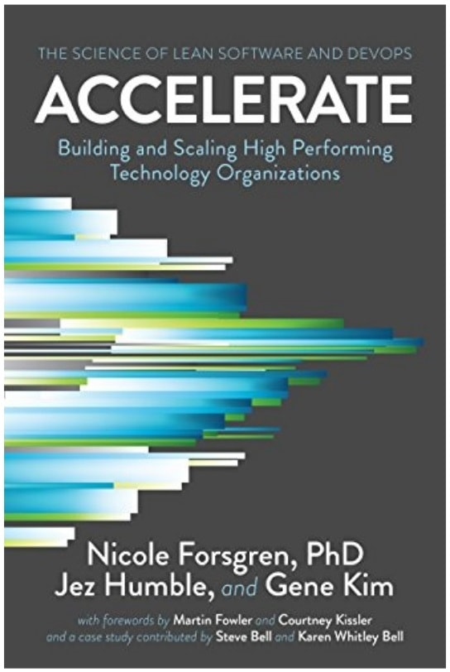
DORA - DevOps Research and Assessment
DevOps Research and Assessment Team: Google Cloud’s devops research team.
Originally independent company started by Nicole Forsgren
She’s the author of Accelerate: The Science of Devops and Lean Software
Puts out Annual State of DevOps report
Industry survey of software development performance.

Slide 12
Dora Metrics
The core devops metrics from DORA (sometimes referred to as the ‘Four Keys’):
Deployment Frequency
Lead time for changes
Time to restore service (MTTR)
Change Failure Rate (CFR)

Slide 13
Deployment Frequency
How often does your organization deploy code to production or release it to end users?
Elite: On-demand (multiple deploys per day)
High: Between once per week and once per month
Medium: Between once per month and once every 6 months
Low: Fewer than once per six months

Slide 14
Lead time for changes
How long does it take to go from code committed to code successfully running in production?
Elite: Less than one hour
High: Between one day and one week
Medium: Between one month and six months
Low: More than six months

Slide 15
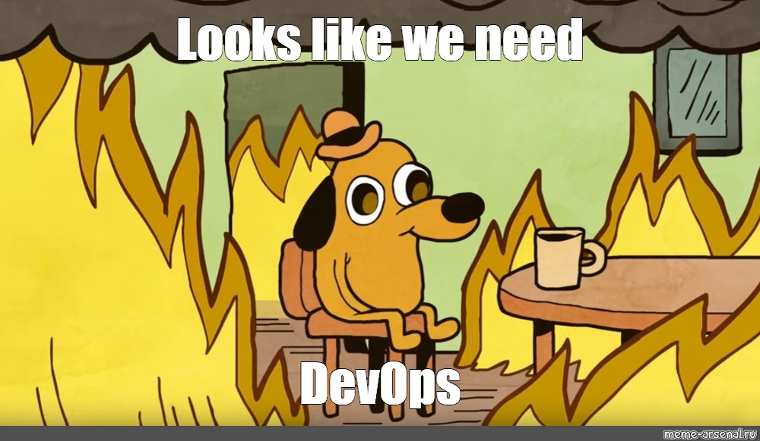
Time to restore service
Mean Time To Recovery (MTTR)
How long does it generally take to restore service when a service incident or a defect that impacts users occurs?
Elite: Less than one hour
High: Between one day and one week
Medium: Between one month and six months
Low: More than six months

Slide 16
Change Failure Rate
What percentage of changes to production or released to users result in degraded service and subsequently require remediation?
Elite: 0-15%
High: 16-30%
Medium: 16-30%
Low: 16-30%

Slide 17
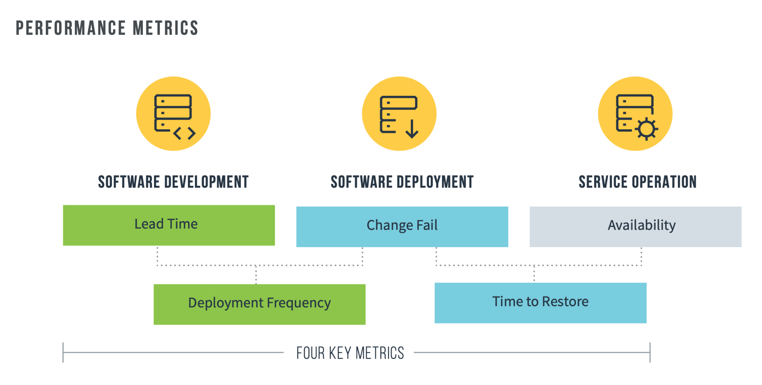
In short: going fast results in higher quality software

Slide 18
DevOps Practices & Tools

Slide 19

CAVEAT:
All practices and tools are context specific and may not be appropriate for your software development environment. In many cases software development and operations may deviate from ‘best practices’ due to contractual or security constraints. Constraints are okay…
Sometimes you get painful constraints

Slide 20
DevOps Practices & Tools
Practices & Tooling:
Version Control
Testing
Deployment Automation
Configuration Management / Infrastructure as code (IaC)
Logging
Monitoring

Slide 21
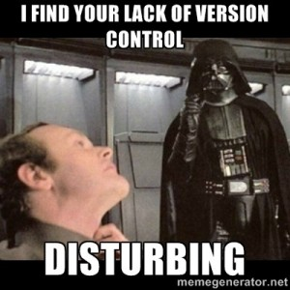
Version Control
Using a version control system (VCS) like git or SVN makes it easier to observe and revise code changes. Do not ‘hot fix’ systems running in production (or if you do, please get those fixes in version control promptly).

Slide 22
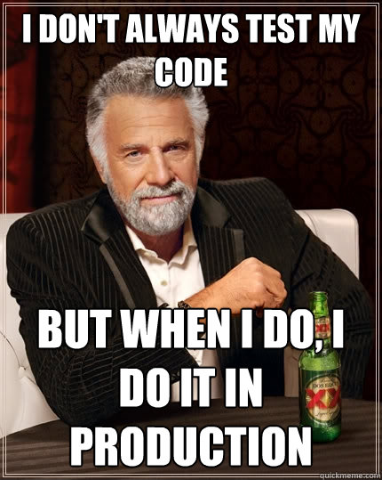
Testing
You are testing your code. Ideally that involves intentionally building and maintaining a set of tests that run automatically as you merge new code into your version control system as part of Continuous Integration (CI). Otherwise angry users will do the testing for you. Your language will have a testing framework or library. Use that.

Slide 23
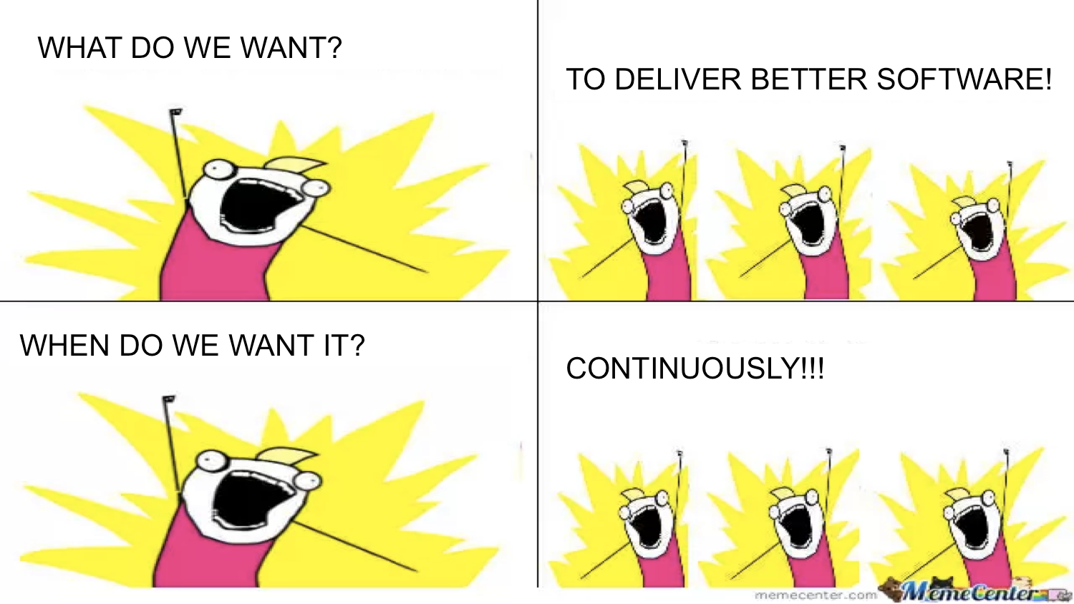
Deployment Automation
Have a process to deploy your code. Ideally your deployment process is fully automated and runs whenever there is new code in version control, resulting in Continuous Delivery (CD) of software.

Slide 24
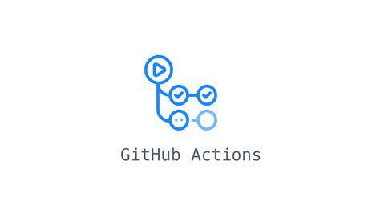
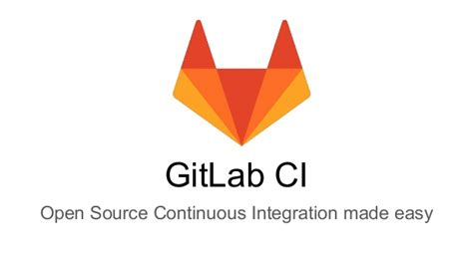
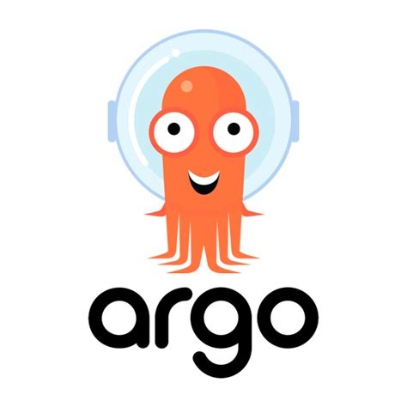
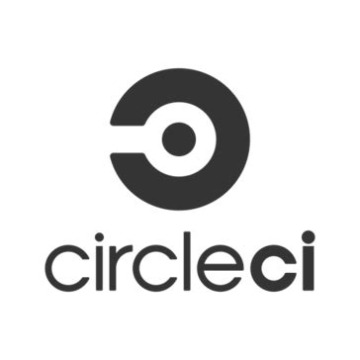

Deployment Automation / CICD tools:
Github Actions
Gitlab CI
Argo CD
CircleCI
Jenkins
Many many more

Slide 25
Configuration Management / Infrastructure as Code
Putting your configuration in code makes deployment more repeatable. We put our code in version control to make running it more repeatable. By putting our infrastructure provisioning and configuration in version control our infrastructure becomes more repeatable. If it’s just something

Slide 26
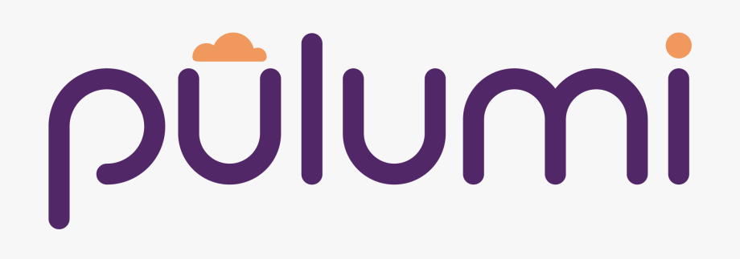
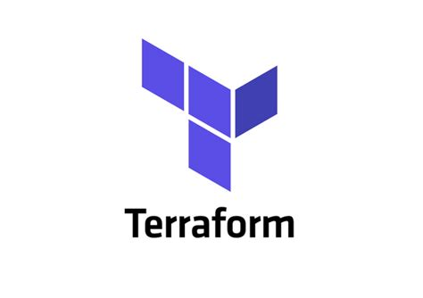

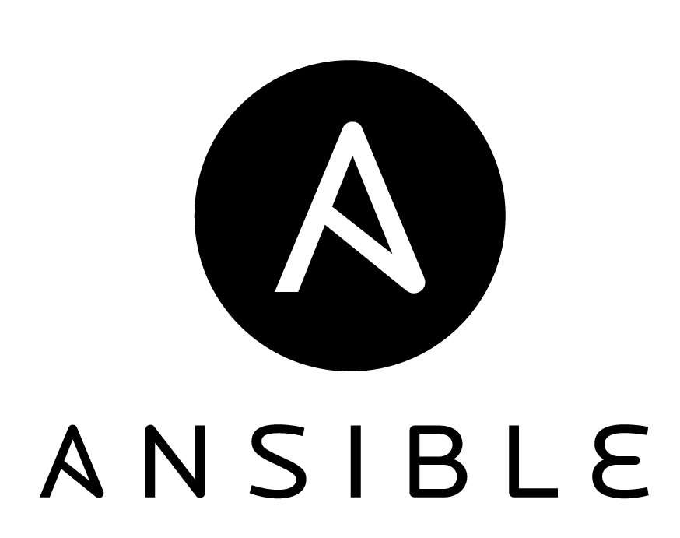
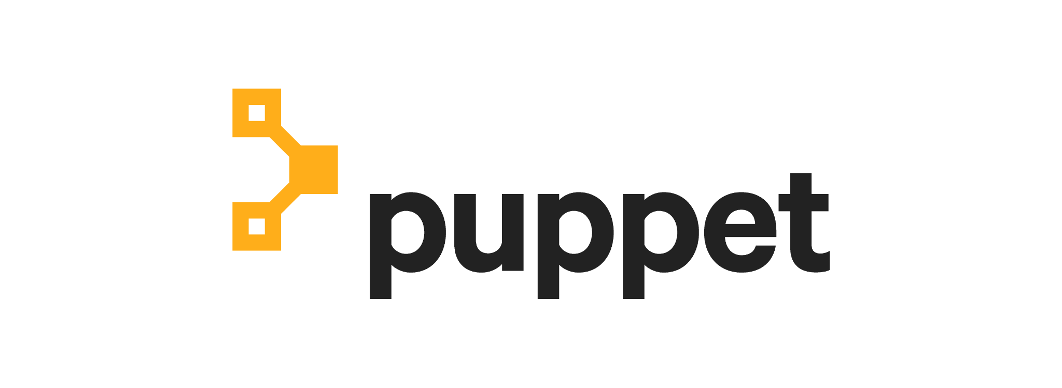
Configuration Management / Infrastructure as Code Tools:
Terraform
Chef
Puppet
Pulumi
Ansible
GCP/AWS/Azure tools
many many more

Slide 27
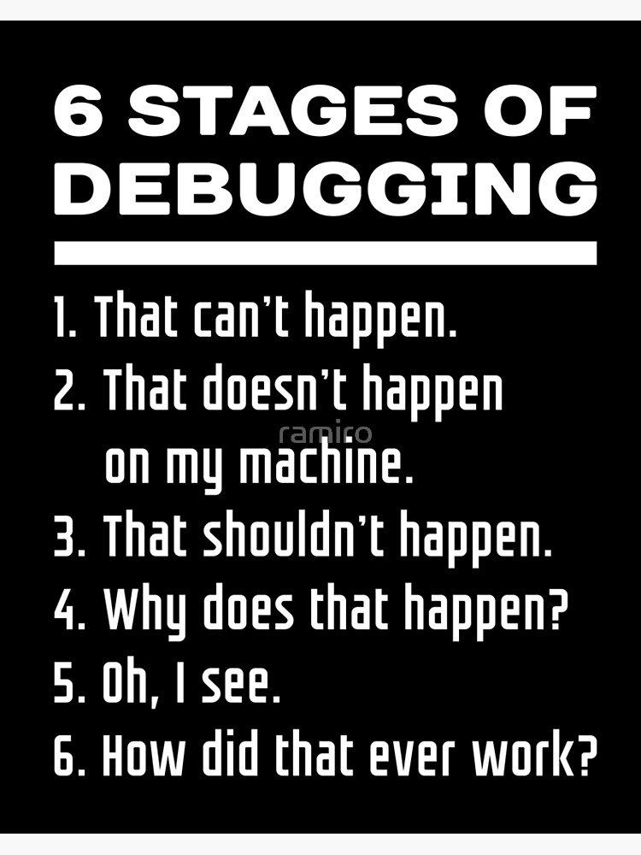
Logging
We log events in applications to help with:
Debugging
Identify errors and unexpected behavior
Confirm correct behavior
Measure performance
Auditing
Business & legal audits
Data Analytics

Slide 28
Monitoring
We monitor deployed software applications so that we can:
Sleep at night
Having insight into system performance increases confidence in reliability
Monitoring usually includes alerting as well
Improve system performance
Identifying performance bottlenecks allows for optimization
Improve user satisfaction / system value
Users don’t like errors and software bugs

Slide 29
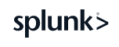




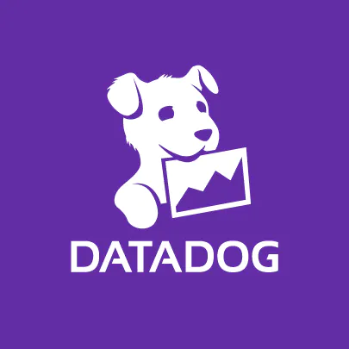
Monitoring Ecosystem
Prometheus
Grafana
Elastic/ ELK
Splunk
New Relic
Sentry
Data Dog
Many many many more

Slide 30
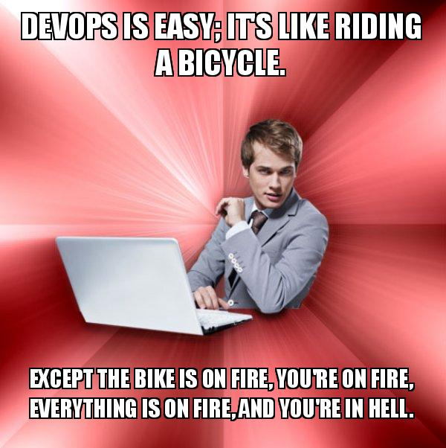
This seems like a lot…
“Shifting left” on operations means eventually needing 10x unicorn developers who understand everything, which will not happen. DevOps is a team endeavor that requires support from the whole business.

Slide 31
DevOps for Data Engineering

Slide 32
DevOps for Data Engineering
It’s the same!... But also different.*
Differences (non exhaustive list):
Data has mass. DevOps & IaC work better as you put more state in VCS. Data is inherently stateful and gets expensive.
Large (larger?) number of third party vendors Lots of great vendors make running it all yourself less appealing, DevOps with significant third party dependencies gets harder.
* This depends a lot on what kind of data engineering you’re doing. Custom built Data Intensive applications will benefit more obviously from ‘conventional’ DevOps practices than data warehouse / orchestration data engineering.

Slide 33
Data has Mass
In application development, the core artifact delivered is an application.
In data engineering, the core artifact delivered is (often) an application that interacts with data.
Larger volumes of data are heavy and stateful
Many CICD tools work best with low/no state.
Tests are harder and more expensive with large data.
Maintaining a dev/qa/prod environment means 3x your data storage if you duplicate data.
Application often becomes commingled with data:
Harder to test code in isolation without data

Slide 34
Larger number of third party tools
Build vs buy decisions in data engineering often heavily tilted towards buy:
Don’t try and develop your own data warehouse unless you really really need it. BigQuery and snowflake are great.
Off the shelf ETL like Stitch and Fivetran are great affordable options.
Harder to do CICD, Monitoring, and Infrastructure as Code on third party SaaS if they do not offer that as a feature. Many don’t.
You can go full open source, in most analytics focused data engineering roles that will not be a cost effective option unless you’re super good at operations.

Slide 35
Conclusion: Data makes DevOps harder, but DevOps makes data engineering easier
Notes:
We’ll never get it perfect, but it’s an iterative process so we’ll be okay.

Slide 36
Questions
Linkedin: https://www.linkedin.com/in/william-angel/
Twitter: @DataDrivenAngel
Github: DataDrivenAngel
Email: will@williamangel.net

Slide 37
Additional Resources:
12 Factor App Principles: https://12factor.net/
Google SRE book: https://sre.google/sre-book/

